Slide 1
The use of mixture distributions in a Bayesian linear mixed effects model
Anirudh TOMER
Promoter: Professor Emmanuel LESAFFRE

Slide 2
What are we dealing with?
Bayesian LMM
Mixture Distribution
Bayesian heterogeneity model

Slide 3

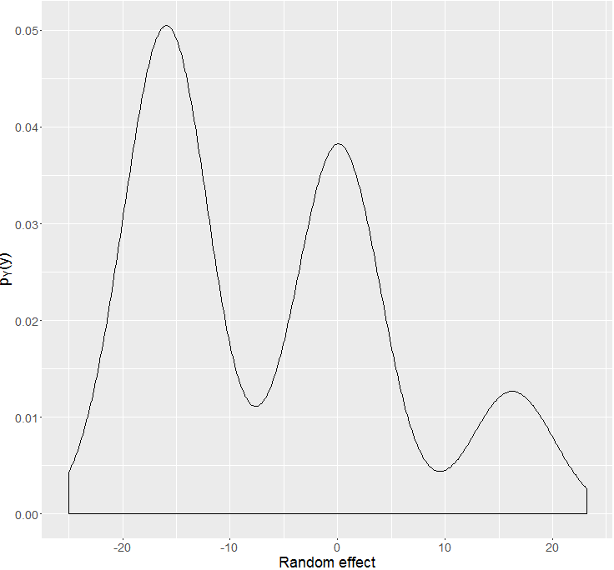
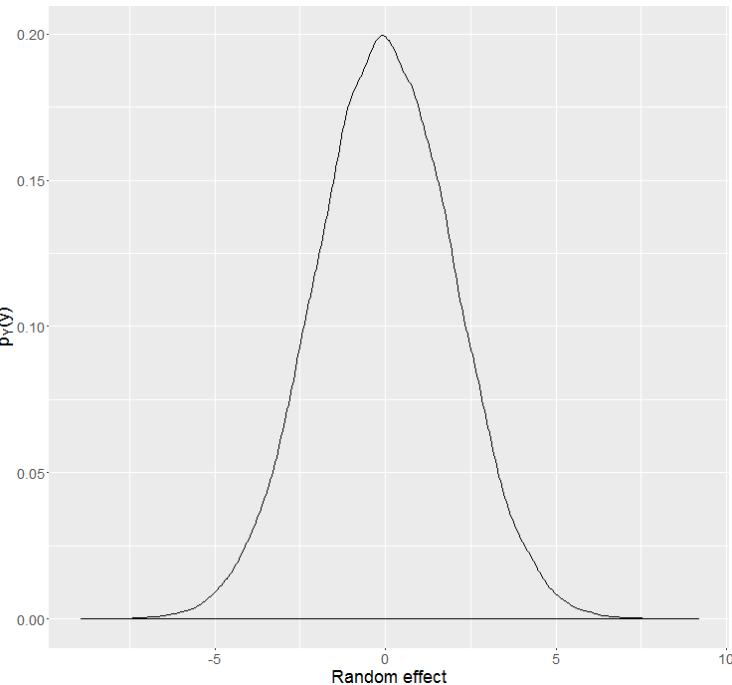





Bayesian heterogeneity model
Gender: Male, Age: 37
Gender: Female, Age: 23
Gender: Male, Age: 41
Gender: Female, Age: 59
Gender: Female, Age: 35
. .
.
. .
.
Gender: Male, Age: 19

Slide 4
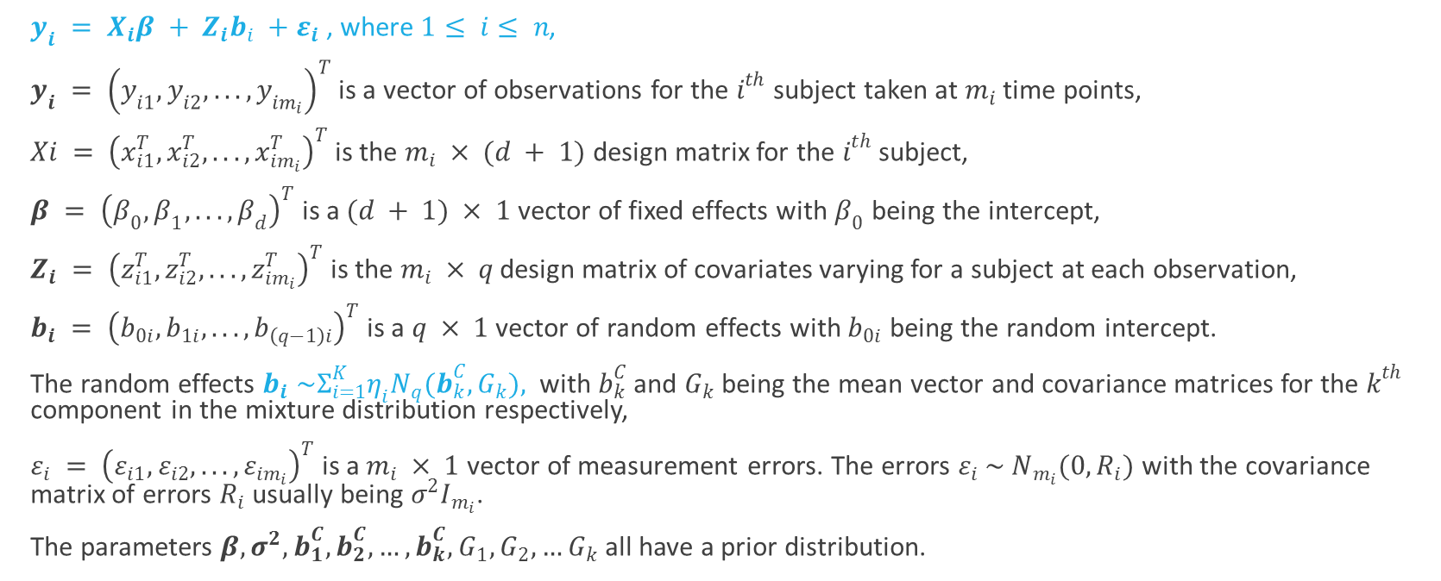
Mathematical notation
$y_{i} = X_{i}β + Z_{i}b_{i} +ε_{i}$, where$1≤ i≤ n$,
$y_{i} = {\left(y_{i1}, y_{i2}, . . . , y_{im_{i}}\right)}^{T}$is a vector of observations for the $i^{th}$ subject taken at $m_{i}$ time points,
$Xi = {\left(x_{i1}^{T}, x_{i2}^{T}, . . . , x_{im_{i}}^{T}\right)}^{T}$is the $m_{i} × (d + 1)$ design matrix for the $i^{th}$ subject,
$β = {\left(β_{0}, β_{1}, . . . , β_{d}\right)}^{T}$ is a $(d + 1) × 1$ vector of fixed effects with $β_{0}$ being the intercept,
$Z_{i} = {\left(z_{i1}^{T}, z_{i2}^{T}, . . . , z_{im_{i}}^{T}\right)}^{T}$ is the $m_{i} × q$ design matrix of covariates varying for a subject at each observation,
$b_{i} = {\left(b_{0i}, b_{1i}, . . . , b_{\left(q−1\right)i}\right)}^{T}$is a $q × 1$ vector of random effects with $b_{0i}$ being the random intercept.
The random effects $b_{i} \sim Σ_{i=1}^{K}η_{i}N_{q}(b_{k}^{C},G_{k}),$ with $b_{k}^{C}$ and $G_{k}$ being the mean vector and covariance matrices for the $k^{th}$ component in the mixture distribution respectively,
$ε_{i} = {\left(ε_{i1}, ε_{i2}, . . . , ε_{im_{i}}\right)}^{T}$ is a $m_{i} × 1$ vector of measurement errors. The errors $ε_{i} \sim N_{m_{i}}(0,R_{i})$ with the covariance matrix of errors $R_{i}$ usually being $σ^{2}I_{m_{i}}$.
The parameters $β,σ^{2}, b_{1}^{C}, b_{2}^{C},…,b_{k}^{C},G_{1},G_{2},…G_{k}$all have a prior distribution.

Slide 5
What is the problem we are facing?
Estimation of component density parameters $θ_{G}$
Estimation of component density parameters 𝜃_𝐺
Criteria for choice of number of components (DIC, Bayes Factor, Predictive methods)
Classification of observations into groups

Slide 6
Simulation study dataset
10 repeated measurements which are equally spaced for all subjects.
Predictors were gender, birth year, time of measurement.
Various versions of the dataset with very clearly distinguishable mixture components to almost fused mixture components were considered.
No serial correlation considered.
In some of the recent runs I also allowed component variances to differ.

Slide 7

DIC (deviance information criteria)
$DIC=\overline{D(θ)}+p_{D}$
Where $p_{D}=\overline{D(θ)}−D(\overline{θ})$is the effective number of parameters in the model.
$D\left(θ\right)=−2\log{p\left(y | θ\right)}+2\log{f(y)}$ is called the Bayesian deviance.
Conditional
Conditional on knowing allocations.
Conditional on knowing the random effect.
Observed
Likelihood based on observed part of the data.
Complete
Model observed and unobserved data both.
Random effect and allocations are unobserved.

Slide 8
Results for 3 well separated components
Fitted Components | DIC 1 | DIC 2 | DIC 4 | DIC 5 | DIC 7
1 | 10531.02 (pD = 15.39) | 10528.17 (pD = 12.53) | 25837.71 (pD = 26.65) | 25966.21 (pD = 155.15) | 9213.49 (pD = 112.43)
2 | 10622.86 (pD = 8.59) | 10642.80 (pD = 28.52) | 26228.60 (pD = 42.98) | 26636.60 (pD = 450.99) | 9166.69 (pD = 76.05)
3 | 13938.77 (pD = 4.41) | 13966.63 (pD = 32.27) | 22875.79 (pD = 63.78) | 23118.10 (pD = 306.08) | 9247.58 (pD = 157.10)
4 | 12364.91 (pD = 8.12) | 12387.15 (pD = 30.36) | 23767.86 (pD = 84.17) | 23965.74 (pD = 282.05) | 9250.44 (pD = 160.53)
5 | 14371.40 (pD = 149.29) | 14256.81 (pD = 34.71) | 23542.39 (pD = 87.64) | 22971.57 (pD = -483.18) | 9258.069 (pD = 166.94)
6 | 14521.31 (pD = 241.9265) | 14081.84 (pD = -197.55) | 23761.01 (pD = 99.70) | 21755.54 (pD = -1905.77) | 9255.67 (pD = 165.18)

Slide 9
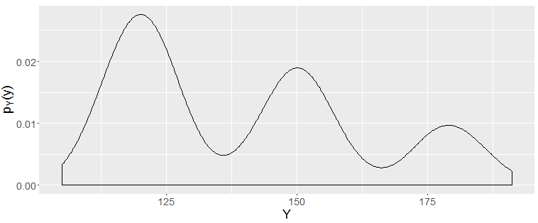
Well separated but unequal proportions

Slide 10
Results for 3 well separated components, un
Fitted Components | DIC 1 | DIC 2 | DIC 4 | DIC 5 | DIC 7
1 | 7028.43 (pD = 11.87) | 7035.24 (pD = 18.68) | 17040.36 (pD = 25.78) | 17076.01 (pD = 61.43) | 6110.43 (pD = 21.68)
2 | 7101.44 (pD = 14.22) | 7101.873 (pD = 14.66) | 17270.44 (pD = 44.16) | 17433.49 (pD = 207.21) | 6061.03 (pD = -21.71)
3 | 7750.93 (pD = 9.28) | 7770.39 (pD = 28.73) | 15382.12 (pD = 64.10) | 15586.91 (pD = 268.89) | 6189.61 (pD = 106.94)
4 | 7783.76 (pD = 7.63) | 7854.453 (pD = 78.32) | 15658.16 (pD = 77.92) | 16037.37 (pD = 457.14) | 6189.28 (pD = 105.68)
5 | 7624.78 (pD = -162.35) | 7816.59 (pD = 29.45) | 15880.63 (pD = 85.80) | 12865.95 (pD = -2928.87) | 6191.27 (pD = 108.37)

Slide 11
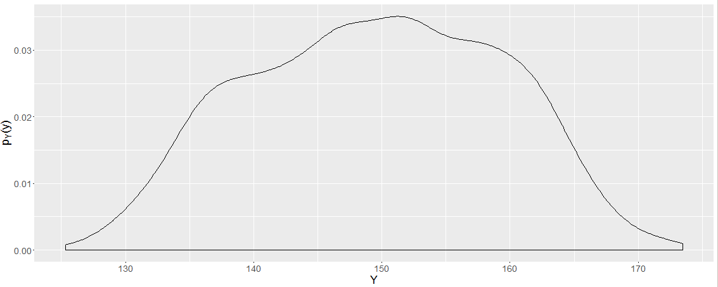
Partially fused components

Slide 12
Results for 3 partially fused components
Fitted Components | DIC 1 | DIC 2 | DIC 4 | DIC 5 | DIC 7
1 | 11652.52 (pD = 16.86) | 11631.82 (pD = -3.85) | 22250.66 (pD = 25.57) | 22449.76 (pD = 224.67) | 9252.85 (pD = 165.91)
2 | 13050.51 (pD = -0.66) | 13045.97 (pD = -5.20) | 23105.93 (pD = 42.46) | 23751.53 (pD = 688.06) | 9235.00 (pD = 157.26)
3 | 15383.37 (pD = -99.51) | 14436.66 (pD = -1046.22) | 23209.09 (pD = 62.97) | 24137.68 (pD = 991.56) | 9238.93 (pD = 161.37)
4 | 15701.01 (pD = 77.61) | 14779.17 (pD = -844.23) | 23517.28 (pD = 75.05) | 22195.75 (pD = -1246.48) | 9230.14 (pD = 153.80)
5 | 16149.49 (pD = 295.3527) | 15155.12 (pD = -699.01) | 23812.6 (pD = 87.08) | 22494.82 (pD = -1230.70) | 9237.79 (pD = 159.73)
6 | 16806.97 (pD = 964.85) | 15324.64 (pD = -517.49) | 24151.71 (pD = 99.13) | 22906.95 (pD = -1145.64) | 9238.55 (pD = 162.99)

Slide 13
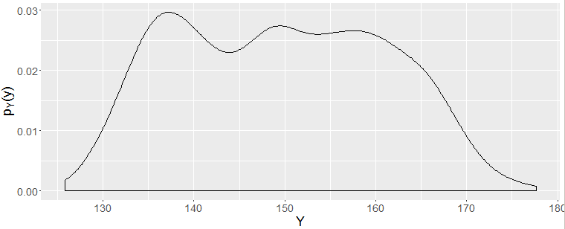
Partially fused components

Slide 14
Results for 3 partially fused components
Fitted Components | DIC 1 | DIC 2 | DIC 4 | DIC 5 | DIC 7
1 | 7478.89 (pD = 13.23) | 7476.65 (pD = 10.99) | 15304.93 (pD = 26.31) | 15428.91 (pD = 150.29) | 6183.127 (pD = 99.80)
2 | 8300.28 (pD = 6.79) | 8383.95 (pD = 90.47) | 15582.35 (pD = 43.18) | 15931.90 (pD = 392.74) | 6181.79 (pD = 104.65)
3 | 9284.91 (pD = -245.00) | 9046.34 (pD = -483.57) | 15528.08 (pD = 62.31) | 15995.44 (pD = 529.68) | 6185.74 (pD = 108.12)
4 | 10047.85 (pD = 182.57) | 9762.34 (pD = -102.94) | 15670.82 (pD = 76.11) | 13523.96 (pD = -2070.75) | 6186.42 (pD = 109.33)

Slide 15
Discussion
DIC 4 works best when components are well separated
pD in DIC1 gives an indication when components are well separated?
Some simulations are incorrect as JAGS does not throw away burn in part
Interpretation of the DIC

Slide 16
Posterior predictive checks
The various summary measures I tried (based on Frühwirth-Schnatter, 2006): mean, variance, skewness, kurtosis and even higher order moments of the observed data
In higher dimensions: Mardia’s skewness and kurtosis and a few more test statistics
In one dimension the posterior of component means can be checked
More detailed questions: Are the mixture proportions correctly identified?
Why some of the posterior checks aren’t working? Perhaps checking for model fit is not a good approach because with more components it is never bad.

Slide 17
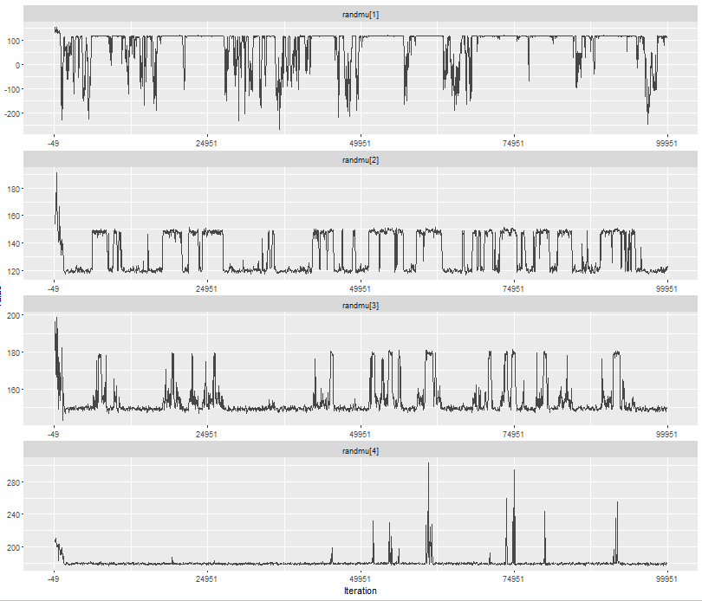
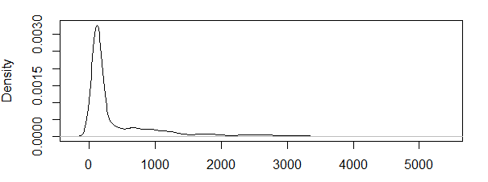
Mahalanobis distance of observed data to components

Slide 18
Bayes Factor
Number of components (Original/Fitted) | 2 | 3 | 4 | 5 | 6
3 | -5201.17 | -5095.25 | -5098.50 | -5092.53 | -5104.56
5 | -8453.78 | -8725.04 | -8662.46 | -8617.31 | -8608.85
Implementation based on Chib (1995)
Loose pattern: Under fitting gives smaller marginal log likelihood

Slide 19
What remains?
More simulations/Confirmatory simulations.
I do lack some of the theoretical foundations.
Modelling the blood donor data.
Answer why things work, when I don’t expect them to? Or why they don’t when I expect them to work?
Double check my code.
I doubt I will be able to run so many observations on my computer.
I am using some parallel processing packages for post MCMC processing.
More complex scenarios.

Slide 20

A few more things
Changing title of the thesis
Thank you MCMC
Feedback and questions from the Panel
Bayesian model selection for Bayesian heterogeneity model.
I get to pursue other activities between work.
Bayesian model selection for Bayesian linear mixed models having mixture distributed random effects.
Have you heard about “beepr”?

